Slide 1
Computer Organization 1
Data Representation
Negative Integers

Slide 2
Negative Integers
There are 4 different ways of representing negative binary integers in computers:
Signed Magnitude
Ones Complement
Twos Complement
Excess (Biased) representation

Slide 3
Signed Magnitude (Sign and Magnitude)
Similar to the way we write numbers – we may precede the number with a sign.
We write minus 12 as -12. That is, the sign is a symbol in the number.
In binary signed magnitude representation in computers, the leftmost bit is used for a sign, 0 for + and 1 for minus.
The remaining bits contain the absolute magnitude of the number.

Slide 4
Signed Magnitude Integers
in one byte signed magnitude representation:
+ 12 = 0000 1100
- 12 = 1000 1100
the negative is formed by changing the MSB to 1.
Note that there are both +ve and –ve representations of 0:
0000 0000 and 1000 0000
Remember that there are 256 permutations of 0 and 1 in an 8-bit byte.
signed magnitude can represent only 255 integers, because of the two representations for zero.

Slide 5
Ones Complement
Ones complement is trivial – to change from positive to negative or vice versa - convert all 1s to 0s, and all 0s to 1s.
Thus, in one byte ones complement representation,
+ 12 = 0000 1100
- 12 = 1111 0011

Slide 6
Ones Complement
That is, the negative is formed by complementing, or ‘flipping’ the bits.
Note again, that there are both +ve and –ve representations of 0:
0000 0000 and 1111 1111
Since there are 256 permutations of 0 and 1 in a byte, with ones complement we can represent only 255 integers in a byte, because of the two representations for zero.

Slide 7
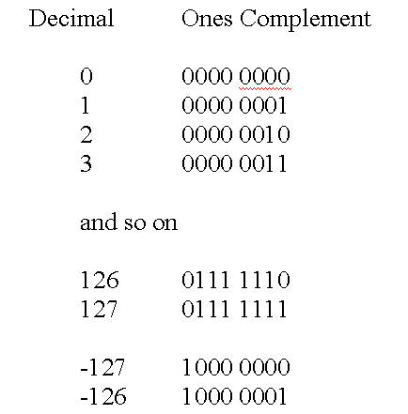
One Complement

Slide 8
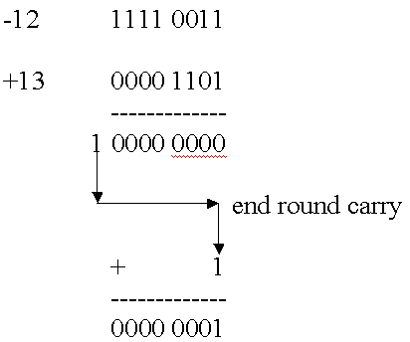
Ones complement
arithmetic can be complex in some cases
Add –12 and + 13 in ones complement byte:

Slide 9
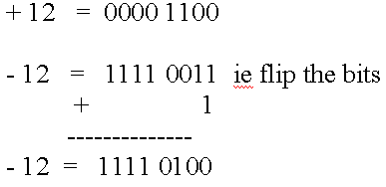
Twos Complement Integers
The negative in 2s complement is formed in a similar way to ones complement: flip all the bits, then add 1. (If the addition results in a carry out from the MSB, discard the carry out. )

Slide 10
Twos Complement Integers
Using 3 bit word (8 representations):
0 000
1 001
2 010
3 011
-4 100
-3 101
-2 110
-1 111

Slide 11
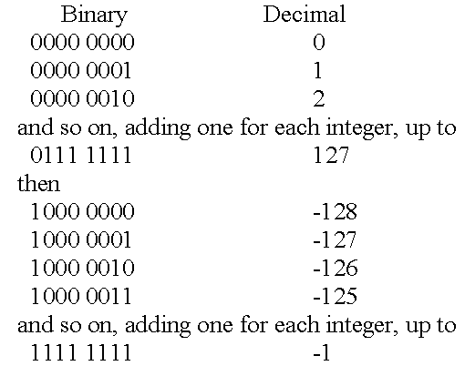
Twos Complement Byte – Only one zero representation

Slide 12
Excess (Biased) representation
In excess or biased notation, the number is treated as unsigned, but is shifted in value by subtracting the bias from it.
Eg one byte Excess 128 (The bias to be subtracted is 128)
Excess 128 Decimal (2s complement)
0000 0000 -128 0
0000 0001 -127 1
0000 0010 -126 2

Slide 13
Excess (biased) Notation
Excess 128 Decimal 2s complement
0000 0000 -128 0
0000 0001 -127 1
…. ….
0111 1111 -1 127
1000 0000 0 -128
1000 0001 1 -127
1000 0010 2 -126
….
1111 1111 127 -1

Slide 14
Excess (biased) Notation
Excess 128 Decimal 2s complement
0000 0000 -128 0
…. ….
1000 0000 0 -128
1000 0001 1 -127
….
1111 1111 127 -1
We see a ‘continuous’ change for values through –2, -1, 0 1, 2, 3, as we add 1 to each binary value.
Whereas in twos complement, the values ‘jump’ from 127 to minus 128, and then reduce by 1 in absolute values all the way down to –1 for the biggest (in pure binary) binary value.

Slide 15
Excess (biased) Notation
Excess 128 Decimal 2s complement
0111 1110 -2 126
0111 1111 -1 127
1000 0000 0 -128
1000 0001 1 -127
We see from the above that excess notation provides for easier comparisons of bit patterns, because of the continuity, that is, 1000 0010 is ‘bigger’ than 0111 1111 in excess 128 but not in twos complement.

Slide 16
Excess byte Notation
To create an excess 128 byte value:
+12 = 12 + 128
= 0000 1100 + 1000 0000
= 1000 1100
This represents 140 (12 + 128) in pure binary.
Another example:
-12 = -12 + 128
= ? + 1000 0000
= 116 = 0111 0100

Slide 17
Summary
There are 4 ways to represent negative and positive integers in computers; main methods in common use now are Twos Complement and Excess notation.
Twos complement:
Given binary x, to find –x, flip the bits and add 1.
Given binary -x, to find x, flip the bits and add 1.
Excess y:
Take decimal x, add y and find the pure binary equivalent.
Given excess binary no. z, subtract y and convert the resulting twos complement number to decimal.

